Slide 1
Hazardous Drug Compounding
Pharmacy Technician Education
ASHP Section Advisory Group on Advancing Pharmacy Practice with Technicians 2018-2019

Slide 2
Table of Contents
Didactic overview of types of hazardous drugs (HD) and their risks
Review of hazardous drug policies and procedures including the process to request alternative duty
Ordering, receiving and stocking of hazardous drugs
Hand hygiene
Use of personal protective equipment (PPE)
Use of negative pressure techniques and closed system transfer devices (CSTDs)
Safe aseptic practices
Containment, clean up, and disposal procedures
Treatment of personal contact and any unintended exposure to a HD

Slide 3
Overview
Hazardous drugs (HD) are drugs that can cause adverse health effects if health care workers that handle (including distribution, preparation, or administration) these products are exposed to them
  Risks: acute and chronic health effects, adverse reproductive outcomes, cancers

Slide 4
Facility HD List
USP 800 requires individual institutions to maintain a list of HDs
  Must include all products on the National Institute for Occupational Safety and Health (NIOSH) list which is separated into 3 categories
  Reviewed every 12 months
  Any new agent or dosage form used must be reviewed against the institution’s hazardous drug list
    If insufficient information is available to classify a drug as hazardous or non-hazardous treat the drug as hazardous until further information is available
Table 1: Antineoplastic HD | Table 2: Non-antineoplastic HD | Table 3: Reproductive Risks
Ex) bleomycin | Ex) cyclosporine | Ex) colchicine

Slide 5
Policies and Procedures
All staff, especially management, should ensure hazardous drug policies are readily accessible to staff and up to date
Requests for alternative duty procedures should be addressed with the human resources department

Slide 6
Assessment of Risk (AOR)
NOISH (National Institute for Occupational Safety and Health) puts out a list of hazardous drugs categorized into 3 tables
  Table 1: Antineoplastic
  Table 2: Non-Antineoplastic
  Table 3: Reproductive Risk
A hospital must follow USP 800 containment strategies for
  All hazardous drug APIs (active pharmaceutical ingredients)
  Table 1 drugs that require further manipulation (ex. antineoplastic that has to be injected into an IV bag)

Slide 7
Assessment of Risk (AOR)
A hospital can choose not to utilize all containment strategies listed in USP 800 if an the drug and dosage form meet criteria for one of the following and an AOR is conducted:
  “Final dosage forms of compounded HD preparations and conventionally manufactured products” (ex. oral chemotherapy that is only counted and repackaged into unit dose packaging)
  NOISH List Table 2 and 3 drugs
AOR must document the alternative “work practices” are used for” specific dosage forms to minimize occupational exposure” and must be reviewed annually at minimum
AOR must document the following considerations (at a minimum)
  Type of Hazardous Drug (NOISH categorization by Table)
  Dosage Form
  Risk of Exposure
  Packaging
  Manipulation

Slide 8
Ordering, Receiving, and Stocking Hazardous Drugs
Ordering
  Establish with the suppliers that hazardous drugs “should be received from the supplier in impervious plastic to segregate them from other drugs and to allow for safety in the receiving and internal transfer process.”

Slide 9
Ordering, Receiving, and Stocking Hazardous Drugs
Receiving
  Hospital must have a designated area for receipt and unpacking of hazardous drugs
    A sign designating the entrance to this hazardous drug handling area must be clearly visible
    This area must be away from a break room or area where food/drink are consumed
    Access to this designated receiving area must be restricted to authorized personnel
  “Personal Protective Equipment (PPE), including chemotherapy gloves, must be worn when unpacking hazardous drugs.”
  “A spill kit must be accessible in the receiving area.”
  Antineoplastics and HD APIs must be removed from their shipping container in a neutral or negative pressure area

Slide 10
Ordering, Receiving, and Stocking Hazardous Drugs
Receiving (continued)
  Hazardous drugs should be removed from external shipping containers outside of sterile compounding or positive pressure areas
  The hospital “must enforce policies that include a tiered approach, starting with visual examination of the shipping container for signs of damage or breakage (visual stains from leakage, sounds of broken glass).
  USP 800 outlines requirements for receiving and handling damaged HD shipping containers with specific directions that apply to “if the shipping container appears damaged” and “if a damaged shipping container must be opened”.
    Damaged shipping containers should be “transported to a C-PEC designated for nonsterile compounding.”
    “If a C-PEC designated for sterile compounding is the only one available, it must be disinfected after the decontamination, deactivation, and cleaning step before returning to any sterile compounding activity.”
  “Hazardous drugs must be delivered to the hazardous drug storage area immediately after unpacking.”

Slide 11
Ordering, Receiving, and Stocking Hazardous Drugs
Stocking/storage
  Hospital must have a designated area for storage of hazardous drugs
    A sign designating the entrance to this hazardous drug handling area must be clearly visible
    This area must be away from a break room or area where food/drink are consumed
    Access to this designated receiving area must be restricted to authorized personnel
  Hazardous drugs must be stored in a way that prevents their spilling or breaking
  Hazardous drugs cannot be stored on the floor
  Antineoplastics requiring manipulation and HD APIs must be stored separately from non-hazardous drugs and should be stored in an externally ventilated, negative pressure room with at least 12 air pressure changes per hour (ACPH).

Slide 12
Ordering, Receiving, and Stocking Hazardous Drugs
Stocking/storage (continued)
  Refrigerated antineoplastics must be stored in a dedicated refrigerator in a negative pressure area with at least 12 ACPH (storage room, *buffer room, or segregated compounding area are acceptable).
  Non-antineoplastic, reproductive risk only and final dosage forms of antineoplastic HD can be stored with other inventory (if allowed by hospital policy).
  Though sterile and nonsterile hazardous drugs can be stored together, nonsterile drugs should not be stored in sterile compounding areas to prevent increased traffic to these areas.

Slide 13
Hand Hygiene
Hands must be washed with soap and water after removing gloves

Slide 14
Use of personal protective equipment (PPE)
Purpose: To provide employees protection from hazardous aerosols and drug residue during preparation of products. Sites must have a policy identifying appropriate PPE to be worn
Includes gloves and gowns

Slide 15
Use of personal protective equipment (PPE)
Gloves
  Must be ASTM-tested chemotherapy gloves (ensure gloves being utilized are ASTM tested)
    Specific number D6978
  Gloves must be powder free (powder may contaminate work area and can adsorb and retain hazardous drugs) and sterile
  Visually inspect gloves for defects prior to use. Do not use if defects seen.
  Two pairs of ASTM- tested chemotherapy gloves must be used when compounding, administering, managing a spill, and disposing of hazardous drugs.
    Outer glove must be sterile for sterile preparations
    Inner glove must be under the gown cuff and the outer glove must be over the gown cuff
  Gloves must be changed every 30 minutes, or when torn, punctured, or contaminated
  Discard of PPE in approved HD waste container inside C-PEC or contain them in sealable bag to discard outside the C-PEC

Slide 16
Use of personal protective equipment (PPE)
Gowns
  Gowns must be worn when handling HDs
  Gowns must be able to protect worker from spills/splashes of HD and waste materials. These gowns must have been tested to resist permeability by HDs
  Disposable
  Polyethylene-coated polypropylene or other laminate materials offer better protection than uncoated materials
  Must close in the back. Front cannot be open. Must have long sleeves with closed cuffs that are elastic or knit.
  No seams or closures that could allow drugs to pass through
  Cloth material or other absorbent materials are not appropriate wear to handle HDs

Slide 17
Respiratory Protection
Personnel who unpack HDs that are not contained in plastic should wear an elastomeric half-mask with a multi-gas cartridge and P100 filter
PAPR should be worn when there is a risk of respiratory exposure to HDs, including:
  An HD spill that cannot be contained to a spill kit
  Any exposure underneath the work surface of a C-PEC
  When there is risk of airborne exposure to powders or vapors

Slide 18
Activity | Gloves | Gown | Hair, Mask, Beard, Shoe Covers | Eye Protection | Respiratory Protection
Receiving of intact product | ✓
Receiving of broken products | ✓ | ✓ | ✓ | ✓ | ✓
Transporting hazardous drugs | ✓
Receiving product in compounding areas | ✓ | ✓ | ✓
Stocking compounding areas | ✓ | ✓ | ✓
Non-sterile compounding | ✓ | ✓ | ✓
Sterile compounding | ✓ | ✓ | ✓
Administering | ✓ | ✓ |  | ✓
Routine clean-up | ✓ | ✓ | ✓
Collection and disposal of patient waste | ✓ | ✓ | ✓ | ✓
Spills | ✓ | ✓ | ✓ | ✓ | ✓

Slide 19
Closed System Transfer Devices (CSTDs)
A supplemental engineering control used in conjunction with primary and secondary control strategies.
A drug transfer device that mechanically prohibits the transfer of environmental contaminants into the system and the escape of HD or vapor concentrations outside of the system
CSTDs limit the potential for generating aerosols during compounding
There is no universal performance protocol by which all CSTDs are evaluated for containment
Users should carefully evaluate the performance claims associated with available CSTDs

Slide 20
Closed System Transfer Devices (CSTDs)
Work practices that must be followed:
  CSTDs used as a supplemental control for compounding shall be used inside a C-PEC
  CSTDs should be used when compounding HDs when the dosage form allows
  CSTDs shall be used when administering HDs when the dosage form allows

Slide 21
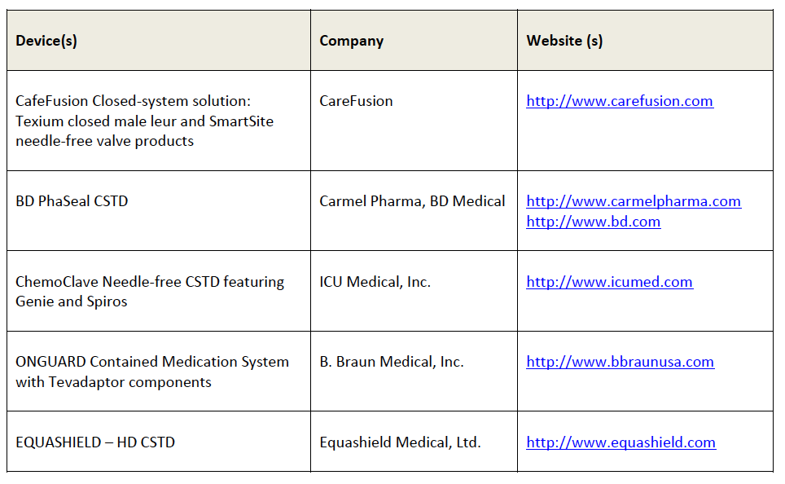
Closed System Transfer Devices (CSTDs)

Slide 22
Safe Aseptic Practices Using Negative Pressure Technique
Perform all manipulation of HDs in Containment Primary Engineering Control (C-PEC)
Observe proper material handling practices before introducing any item into the ISO Class 5 C-PEC
  Remove any unnecessary supplies
  Decontaminate the deck between different types of HDs
  Disinfect the deck with sterile 70% IPA
  Disinfect each component immediately before introduction to the C-PEC
  Arrange items so not to impede first air
  Open items to the left or right of direct compounding area
Swab the vial septum with sterile 70% IPA and allow to dry
Perform manipulations in the direct compounding areas and in a way in which critical sites remain in unobstructed HEPA filtered air (first air)
Use a syringe that is 25% larger than the total dose
Carefully attach the needle and syringe being careful to avoid touch contamination of either critical site
Draw up the amount of air that is equal to the total dose to be drawn up

Slide 23
Safe Aseptic Practices Using Negative Pressure Technique (continued)
Insert the needle into the septum being mindful of the first air coming down from the top of the C-PEC
  Without touching the length of the plunger and with the needle above the fluid level, pullback on the plunger slightly to create a negative pressure within the vial
  Invert the vial and with needle below the fluid level, withdraw no more than 15-25% of the dose into the syringe, until you feel resistance. Slowly transfer small amounts of the medication into the syringe as equivalent amounts of air are exchanged for fluid
  Each time allow the syringe plunger to return to original position and never let plunger go above that original position (as it may result in positive pressure)
  Repeat these steps until the total volume is drawn up.
  With the needle still in the vial, remove all air bubbles and adjust to the final dose
  Once the final dose is measured, lace the vial upright on the deck and withdraw a slight amount of air through the needle to clear the hub of the syringe of drug. No additional air should be drawn into the syringe.
  Carefully withdrawal the needle and syringe from the vial
  Follow proper material handling procedures for removing hazardous compounded sterile preparations for the C-PEC

Slide 24
Containment, clean up, and disposal procedures
Considerations:
  Agents used need to be appropriate for the surface material and type of HD
  How to apply?
    Use wet wipes with appropriate solution
    Do not use spray bottles to avoid spreading HD
  Make sure area is well ventilated and wear appropriate PPE

Slide 25
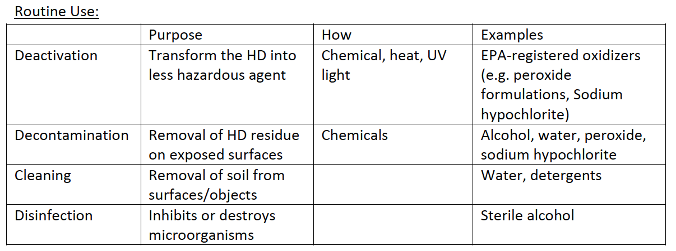
Containment, clean up, and disposal procedures

Slide 26
Containment, clean up, and disposal procedures
Steps of Cleaning Process
Deactivation – goal of complete surface deactivation
Decontamination – remove HD residue from all surfaces
  When? Wipe containers before compounding in hood to reduce residue
  Decontaminate at least daily, w/ any spill, between compounding of different HDs, before/after certification, after hood is turned off, when ventilation tool is moved
Cleaning – removal of contaminants, not to be done while compounding is occurring
Disinfection (for sterile compounding) – last step, areas must be cleaned first; inhibits microbial growth
Frequency of cleaning process

Slide 27
Containment, clean up, and disposal procedures
Equipment used in HD compounding – daily (decontamination, cleaning) or after each use
Treatment of personal contact and any unintended exposure
Direct skin or eye contact requires immediate evaluation
Spill Control
  Proper training – spill management and PPE/respiratory equipment
  Tend to immediately by qualified personnel
  Spill kits available in all areas where HDs are
  Received, stored, compounded, prepared, handled, disposed of
  Dispose of spill kit contents in hazardous waste containers
  Documentation of event & follow up for future prevention
  Definition of a spill - Internal policies to instruct on size of spill & scope for clean up
  Definition of an “exposure” event

Slide 28
Containment, clean up, and disposal procedures: Disposal
Must consider and plan for disposal of different materials
  “Trace” hazardous waste
  Containers/tubing with <3% by weight of HD remaining
  All disposable supplies involved in compounding or cleaning
  PPE used in compounding
  “Bulk” hazardous waste
  Containers/tubing w/ >3% by weight of HD remaining
  Significantly contaminated supplies and PPE used in compounding, cleaning, etc
  Materials used in cleaning up spills

Slide 29
Treatment of Personal Contact and Any Unintended Exposure
Personnel who are potentially exposed to a HD or who have direct skin or eye contact require immediate evaluation
The occurrence of exposure-related health changes should prompt immediate reevaluation of primary preventive measures
  Perform post-exposure evaluation tailored to the type of exposure
  Compared performance of controls with recommended standards
  Conduct environmental sampling
  Verify all engineering controls are in operating conditions
  Develop an action plan to prevent future exposures

Slide 30
References
The Pharmaceutics and Compounding Laboratory. https://pharmlabs.unc.edu/labs/parenterals/vial.htm. Accessed May 13, 2018.
CriticalPoint. Pharmacy OneSource Blog. Clinical Corner: Leveraging Technology to Prevent Catheter-Associated Urinary Tract Infections (CAUTI). http://blog.pharmacyonesource.com/negative-pressure-compounding.-written-by-critical-point. Accessed November 13, 2018.
Power LA. Closed-System Transfer Devices for Safe Handling of Injectable Hazardous Drug. https://www.pharmacypracticenews.com/download/CSTD_ppn0613_WM.pdf. https://www.pharmacypracticenews.com/download/CSTD_ppn0613_WM.pdf. Published June 2013. Accessed November 13, 2018.
The National Institute for Occupational Safety and Health (NIOSH). Centers for Disease Control and Prevention. https://www.cdc.gov/niosh/topics/hazdrug/default.html. Published November 5, 2018. Accessed November 13, 2018.
U.S. Pharmacopeia. USP. http://www.usp.org/. Accessed November 13, 2018.
Wilson JP, Solimando DA. Aseptic technique as a safety precaution in the preparation of antineoplastic agents. Hospital Pharmacy. 1981;100:565-566.

